Slide 1
W200 Python Fundamentals for Data Science
Course Overview

Slide 2

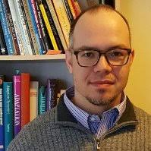
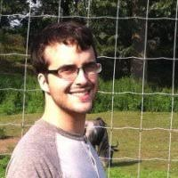
Course Overview | Instruction Team

Slide 3
Course Overview | Agenda
Review Goals Course Basics The Student Experience The Curriculum Discussion Activity Student Showcase Wrap Up

Slide 4
Review Goals | The Wisdom of Drew
Develop a shared understanding of program curriculum
Identify outcomes for each course
Identify gaps and overlaps between courses
Share strategies around instruction and tech use
Assume others know very little about your course

Slide 5
Course Overview | Agenda
Review Goals Course Basics The Student Experience The Curriculum Discussion Activity Student Showcase Wrap Up

Slide 6
Course Basics | Big Picture
An introduction to programming and an introduction to dataset manipulation, all in Python
Focus is on theory as well as syntax
Students leave able to solve programming problems, comfortable in a variety of Python tools, and able to to troubleshoot and learn new libraries on the fly
Students leave comfortable using git and GitHub on team projects
Notes:
Mention Summer Session

Slide 7
Course Basics | First 8 Weeks - Programming
Unit 1 | Introduction, the Command Line, Source Control
Unit 2 | Starting Out with Python
Unit 3 | Sequence Types and Dictionaries
Unit 4 | More About Control and Algorithms
Unit 5 | Functions
Unit 6 | Complexity
Unit 7 | Classes
Unit 8 | Object-Oriented Programming
Individual Object Oriented Project

Slide 8
Course Basics | Last 6 Weeks - Data Analysis
Unit 9 | Working With Text and Binary Data
Unit 10 | NumPy
Unit 11 | Data Analysis With Pandas
Unit 12 | More Analysis With Pandas
Unit 13 | Testing
Data Analysis Group Project

Slide 9
Course Basics | Student Profile
Students come from a wide variety of programming backgrounds
We start each semester with a “diagnostic survey” to get a handle on the current class
Notes:
Mention Summer Session

Slide 10
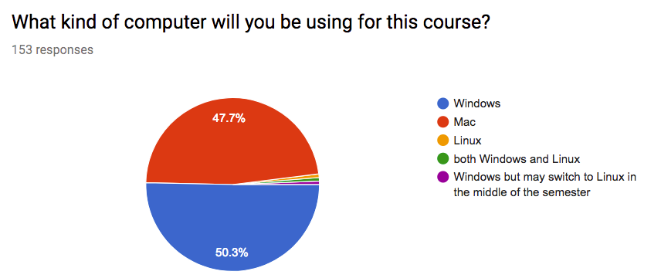
Course Basics | Student Profile
We don’t advocate pie chart use, but this is the Google Sheets default.

Slide 11
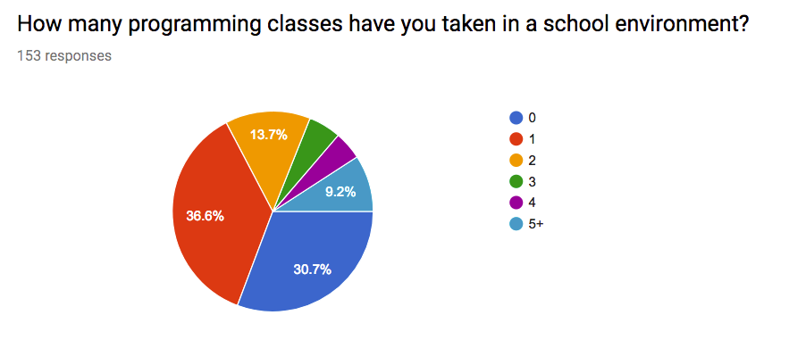
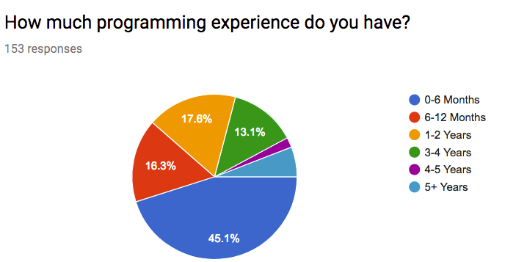
Course Basics | Student Profile

Slide 12
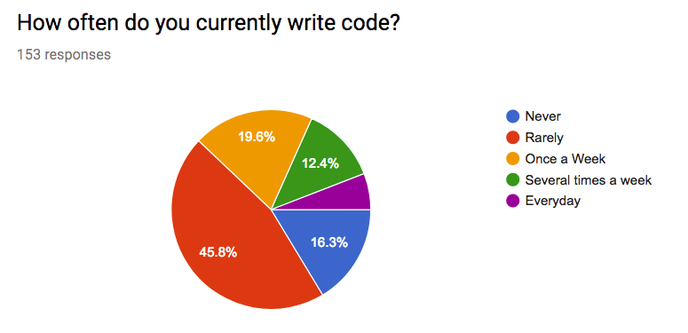
Course Basics | Student Profile

Slide 13
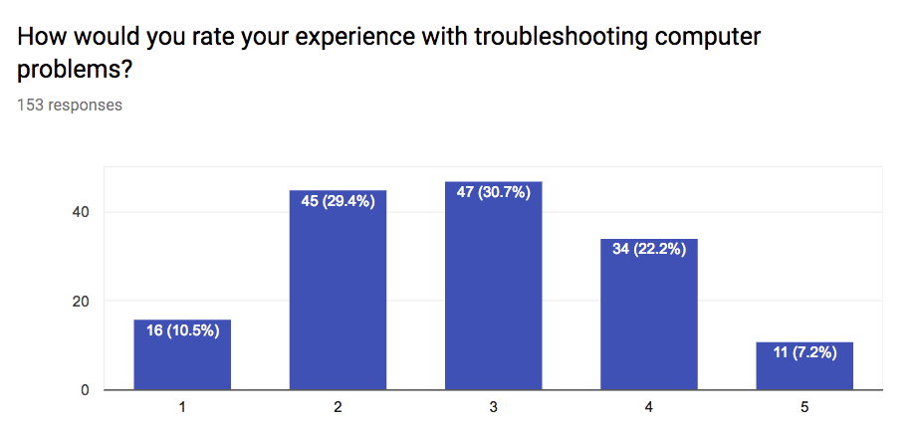
Course Basics | Student Profile

Slide 14
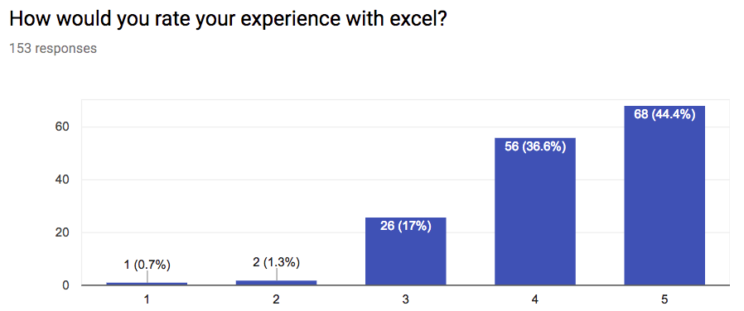
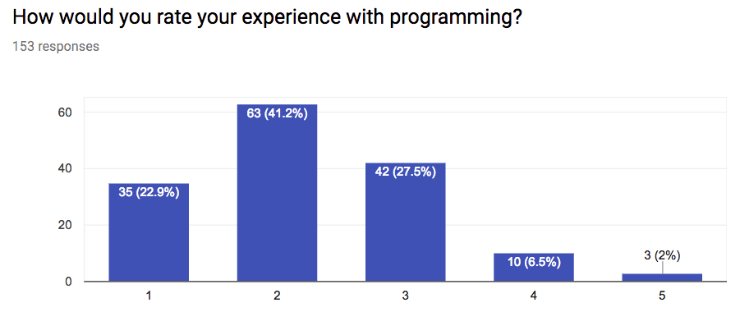
Course Basics | Student Profile

Slide 15
Course Overview | Agenda
Review Goals Course Basics The Student Experience The Curriculum Discussion Activity Student Showcase Wrap Up

Slide 16
The Student Experience | Grading
Weekly Homework (30%)
Project 1 object oriented, individual (20%)
Project 2 data analysis, group (20%)
Participation (10%)
Midterm (10%)
Final (10%)

Slide 17
The Student Experience | Schedule
https://docs.google.com/spreadsheets/d/1s1FZzV-8Mw4FjYZc_2j-knD76P8ehLMKt4w7UHYN5_I/edit?usp=sharing

Slide 18
The Student Experience | GitHub
Installation: https://github.com/MIDS-INFO-W18/Installation
All Course Asynchronous Materials: https://github.com/MIDS-INFO-W18/Course-Syllabus
Homework: https://github.com/MIDS-INFO-W18/assignments_upstream_fall17
Free for All: https://github.com/MIDS-INFO-W18/github-playground

Slide 19
The Student Experience | Submitting Homework
Students pull homework from a shared repository, and push their solutions to a private repository that only they can see.
We use GitHub “teams” to control access across our repositories.
Demo: https://github.com/MIDS-INFO-W18

Slide 20
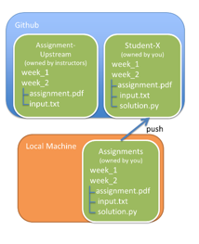
The Student Experience | Submitting Homework
pull

Slide 21
The Student Experience | Behind the Scenes
Instructor Full Content: https://github.com/MIDS-INFO-W18/assignments-instructors
Includes:
Upcoming homework assignments, projects, and exams (not yet released)
Solution keys
Files under development
“Fun” code we accumulate over the years!

Slide 22
The Student Experience | Truly Cross-Section
Students have access to a shared Google Group across all sections. Instructors promise to respond to questions in a timely fashion https://groups.google.com/forum/#!forum/w200-python-2017-fall
Students are welcome to join any office hours for the course
Gunnar/Chris get to know each other’s students, to a point
Paul joins for final project presentations when possible
Students encouraged to use Slack to meet each other https://ucbischool.slack.com/messages/C5AL99BU6/

Slide 23
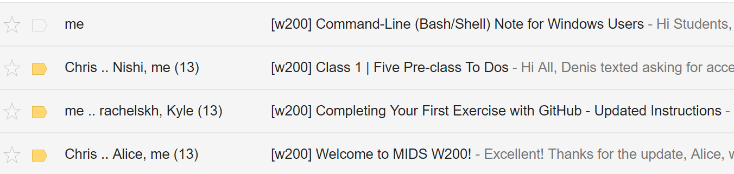
The Student Experience | Course Kickoff
Course is kicked off each year using a set of email “templates” developed over time.

Slide 24
The Student Experience | Course Kickoff
Students complete a pre-class 1 assignment
We pay close attention in the first few weeks to make sure nobody gets left behind, including individual follow-up as needed
No Python taught in the first week
Students learn how to use git, GitHub, and the command line. These tools are then used throughout the course
Students who fail HW 1 are asked to resubmit

Slide 25
The Student Experience | Live Sessions
In live sessions, we:
Use a presentation such as this one
Recap major points of the course async
Demo important concepts on our own machines
Start discussion around tricky concepts
Provide breakout activities for most weeks
New this semester: The submarine

Slide 26
Course Overview | Agenda
Review Goals Course Basics The Student Experience The Curriculum Discussion Activity Student Showcase Wrap Up

Slide 27
The Curriculum | First 8 Weeks - Programming
Unit 1 | Introduction, the Command Line, Source Control
Unit 2 | Starting Out with Python
Unit 3 | Sequence Types and Dictionaries
Unit 4 | More About Control and Algorithms
Unit 5 | Functions
Unit 6 | Complexity
Unit 7 | Classes
Unit 8 | Object-Oriented Programming
Individual Object Oriented Project

Slide 28
The Curriculum | Programming
The first eight weeks of our course are designed to challenge students, culminating in a student-designed project and a midterm.
Students are exposed to a wide range of programming tools, and the homework gets progressively harder as more tools must be integrated to solve problems
Important theory is also covered: pseudocoding, algorithm complexity, recursion
We thought it would be fitting (and fun!) to show you context into the course through an example homework problem from each week.

Slide 29
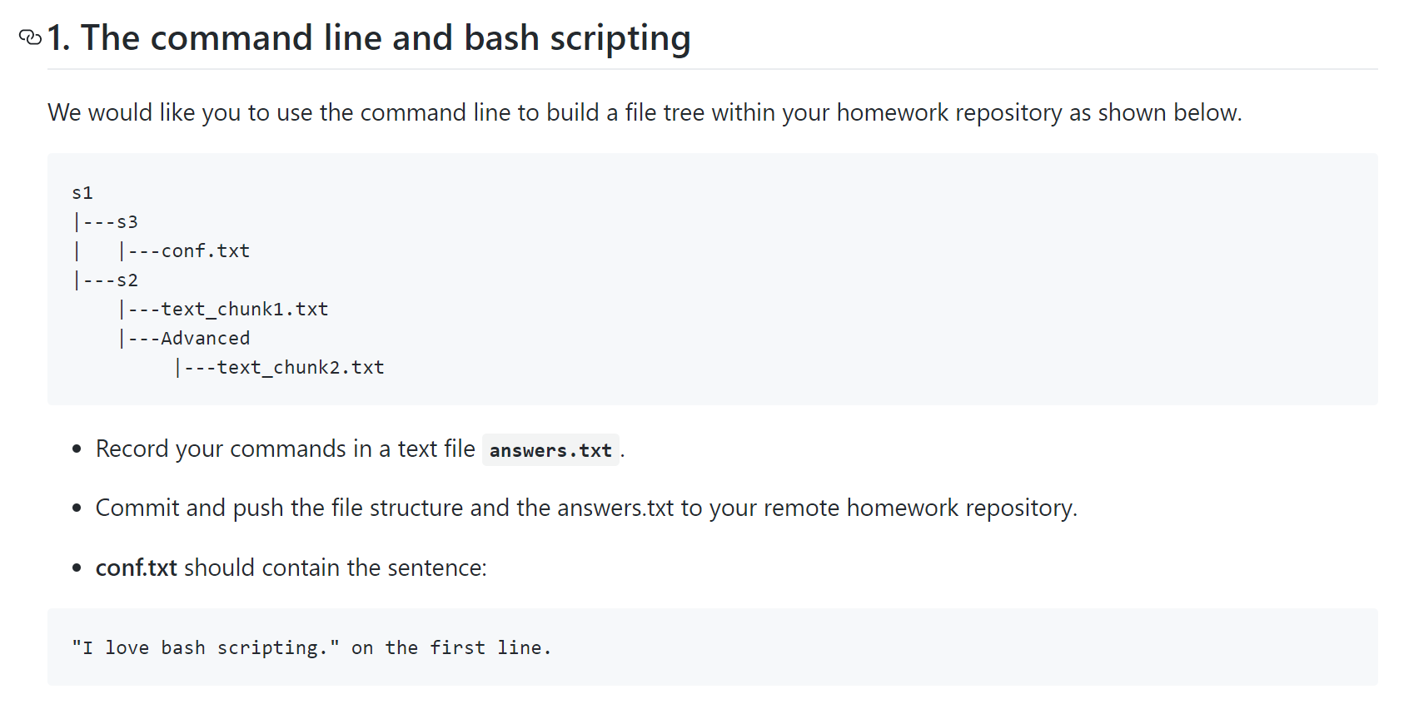
Programming | Homework Examples - Unit 1

Slide 30
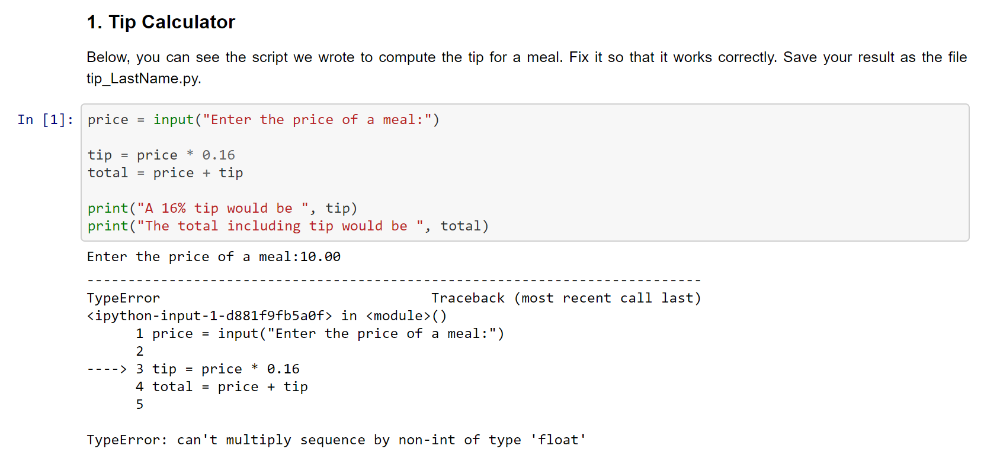
Programming | Homework Examples - Unit 2

Slide 31
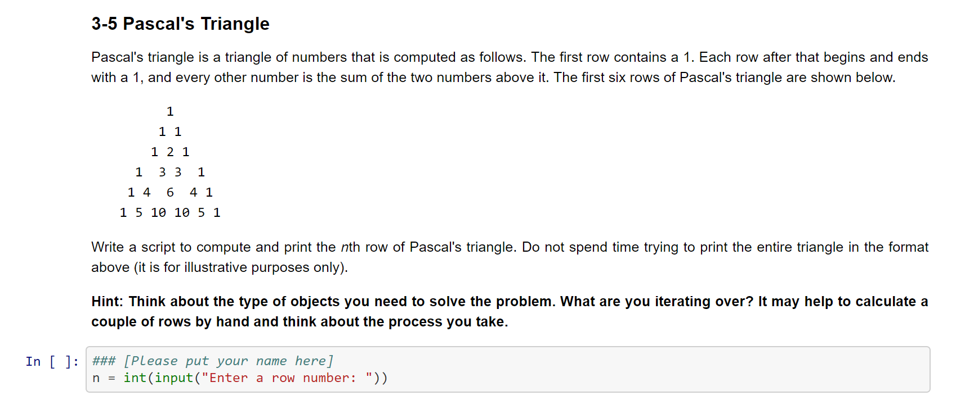
Programming | Homework Examples - Unit 3

Slide 32
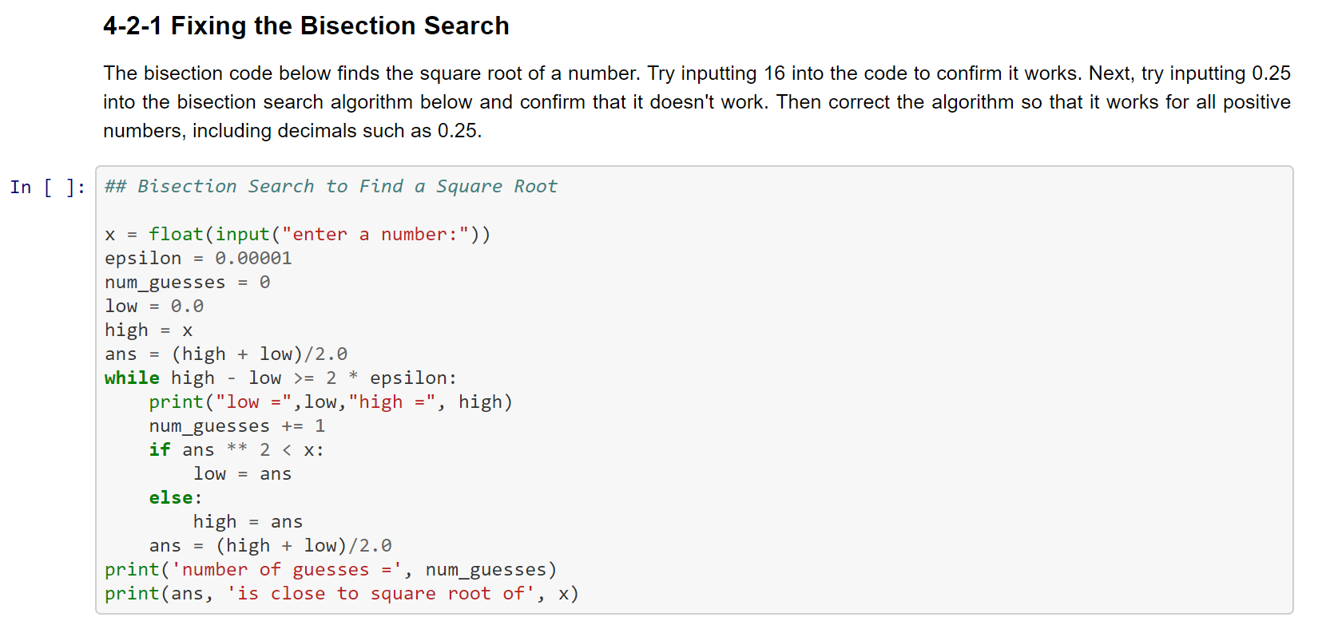
Programming | Homework Examples - Unit 4

Slide 33
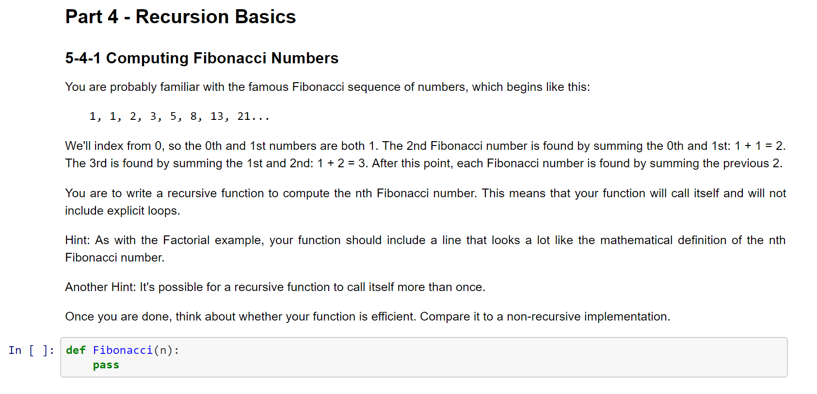
Programming | Homework Examples - Unit 5

Slide 34
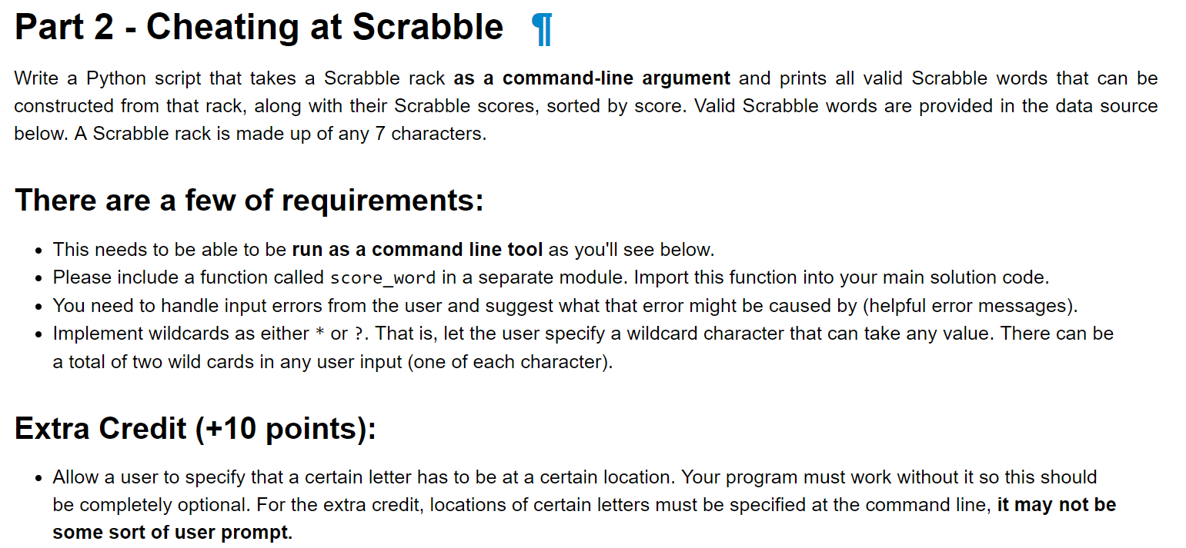
Programming | Homework Examples - Unit 6

Slide 35
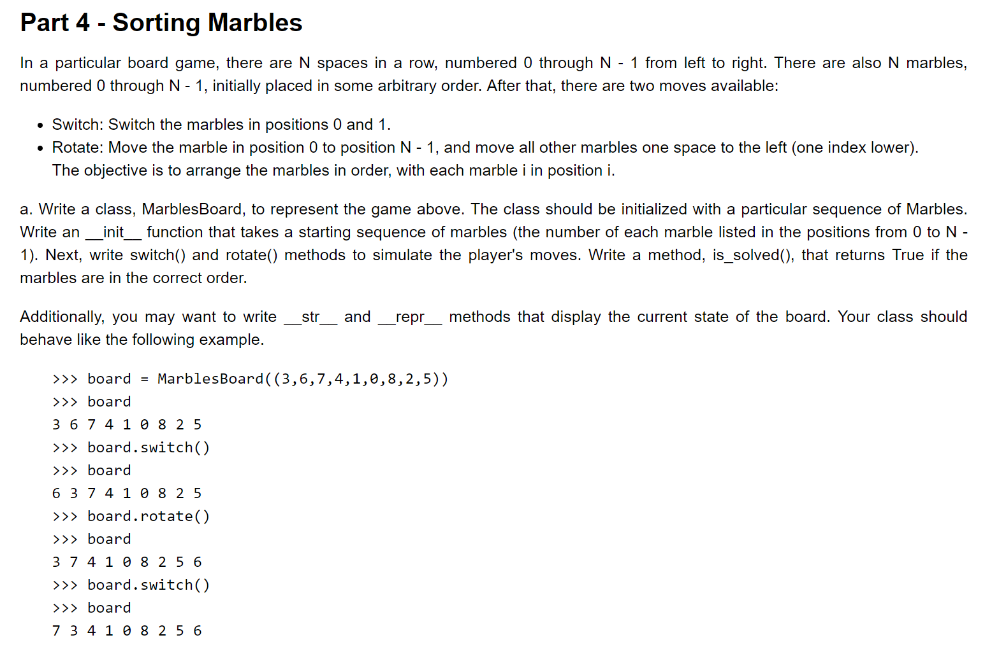
Programming | Homework Examples - Unit 7

Slide 36
Project 1 | Your Mission
Create a small, object-oriented program of your choosing:
Examples:
An ATM
A flower shop
An adventure game
Something relating to your everyday work

Slide 37
Project 1 | Code
Python 3 code, 300-500 lines (750 max)
All code should be well commented!
Must use Object Oriented design and classes
Demonstrate various flow controls and data types
Robust to common user errors and exceptions

Slide 38
Project 1 | Expectations
The user will interact with your program via Terminal/Shell
Three documents due before your class on 3/14 or 3/16:
Proposal (10%)
Code(s) (80%)
Reflective Summary (10%)
You will demo your progress in a breakout room (3/7 or 3/9)
You may only use Python libraries that come installed with Anaconda

Slide 39
Project 1 | Proposal
Describe your project concept
Pseudocode your major classes and functions
Briefly describe the purpose of each class
List expected functions belong to each class
List inputs and outputs for each function
Instructors will “approve” your draft proposal
Coding is iterative. Your final code may not match the proposal exactly

Slide 40
Project 1 | Reflection
Submit a 1-page reflection with your code
Instructors will read your reflection before grading your project
Tell us how to use your project!
Discuss challenges you faced and how you overcame them

Slide 41
The Curriculum | Last 6 Weeks - Data Analysis
Unit 9 | Working With Text and Binary Data
Unit 10 | NumPy
Unit 11 | Data Analysis With Pandas
Unit 12 | More Analysis With Pandas
Unit 13 | Testing
Data Analysis Group Project

Slide 42
The Curriculum | Data Analysis
The last six weeks of our course are designed to teach students how to start thinking about analyzing data. This includes developing questions, sanity checking and exploring, transforming, and basics of plotting and visualization. Students then apply everything they have learned in their second project
We often discuss how the lessons of class extend beyond Python, and share stories from our personal experience in the classroom setting
We are planning to re-record a large portion of the asynchronous materials for this section
Homework in the second part of the course is more guided than the first.

Slide 43
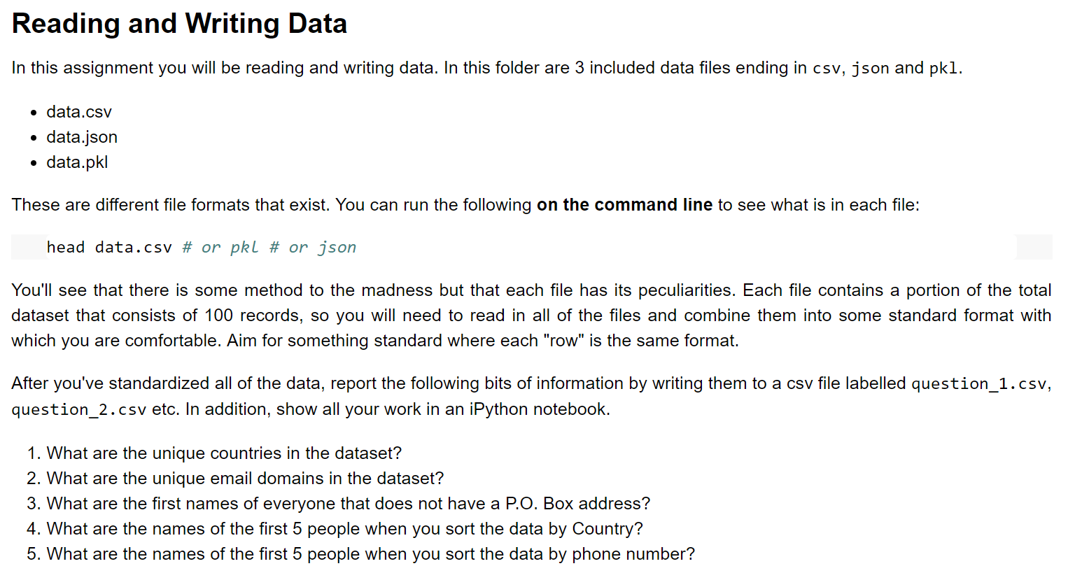
Programming | Homework Examples - Unit 10

Slide 44
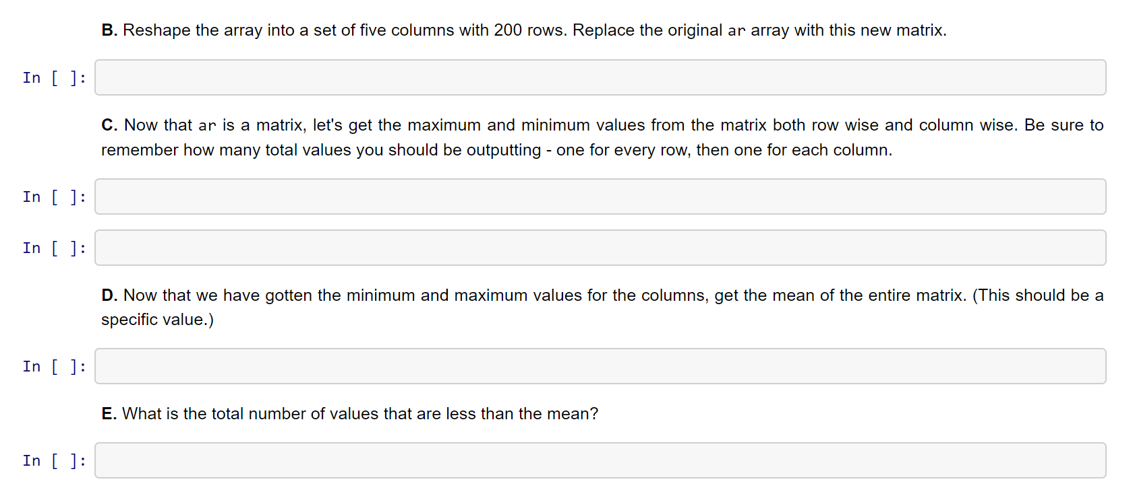
Programming | Homework Examples - Unit 11

Slide 45
Programming | Homework Examples - Unit 12
To be shown in “Activity” demo

Slide 46
Project 2 | Proposal
With your group (2-3 people) come up with a 1 - 2 page proposal about the questions that you intend to ask of the data. This should include:
Initial plots, figures or tables.
References to column names and the analysis that they may provide.
Additional datasets that you plan on including in your analysis like the weather data. This means links, columns that you'll join on, etc.
What you plan to cover in the final report and how you plan on organizing it.

Slide 47
Project 2 | The Report
The report will be 8+ pages (including appropriately sized figures) and will be a report on what you found out from the data. This should focus on telling stories and explaining the narrative of the exploration and challenges associated with that. The report should not include any code - all code should be included in a sub-folder in either plain python files or in jupyter notebooks.
For the report, any graph, table, or figure should be annotated with why it is included. This is really to enforce just slapping graphs in your report that have no meaning.

Slide 48
Project 2 | Groups
Discuss Project Groups
One option is to plan based on your availability in this tracker:
https://docs.google.com/spreadsheets/d/1vgC9U0nKJS814oVi2UAqllBaRz6ItjUF7d1EghOuAkk/edit#gid=782266616
Please add your project repro location

Slide 49
Project 2 | Forming Hypotheses
Which comes first? The question(s), or the data?
Data First - e.g., if your company collects data in course of business
Question First - e.g., if you have a strategic or research question to answer.
For this project, we suggest an iterative approach.

Slide 50
Project 2 | Forming Hypotheses
For this project, we suggest an iterative approach.
Look through potential data sources
Discuss questions that could be interesting
Confirm that the data source can answer the question
If “yes”, develop your proposal
If “no”, ask if there are similar questions you can answer with your data. OR find a new dataset.
Note: You may decide to combine multiple data sets for your project. For example, merging weather data onto traffic data to get additional insights. You can brainstorm this kind of combination as you look at data.

Slide 51
Course Overview | Agenda
Review Goals Course Basics The Student Experience The Curriculum Discussion Activity Student Showcase Wrap Up

Slide 52
Discussion | Individualized Grading
We have become known for providing students with individualized feedback on their work, but as we grow that is no longer sustainable.
Discuss what we have done before, and NBGrader as an option to partially automate

Slide 53
Discussion | Flexible Exam Schedules
Our exams must each be completed within 24 hours, however, students are allowed to pick what day within a week they spend
We have worked with 2U to set up a method of accomplishing this

Slide 54
Course Overview | Agenda
Review Goals Course Basics The Student Experience The Curriculum Discussion Activity Student Showcase Wrap Up

Slide 55

Activity | Let’s Code in Pandas!

Slide 56
Activity | Let’s Code in Pandas!
You are about to embark on an actual homework assignment… to analyze primary 2016 presidential campaign funding in California!
It is one of the easiest assignments in the course:
We purposefully walk them through what to do step by step
When we debrief the assignment, students discuss what they learned about the election
Students actively apply what they have learned while completing Project 2
We also have an extended demo where we show them how to plot data

Slide 57
Activity | Let’s Code in Pandas!
Please clone into the following repository:
https://github.com/MIDS-INFO-W18/W200CourseOverview.git
Find the pandas exercise here:
W200CourseOverview/exercises/PandasExr.ipynb
Download the dataset from here:
ftp://ftp.fec.gov/FEC/Presidential_Map/2016/P00000001/P00000001-CA.zip

Slide 58
Course Overview | Agenda
Review Goals Course Basics The Student Experience The Curriculum Discussion Activity Student Showcase Conclusions

Slide 59
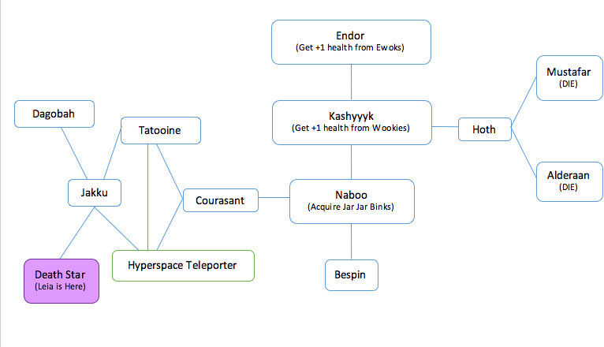
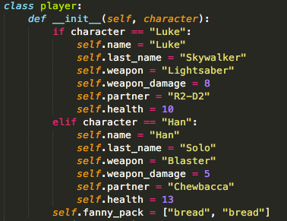
Student Showcase | Project 1 - Object Oriented
Star Wars by Manish Singh
In the repository: W200CourseOverview/project_1/Star_Wars_Manish_Singh/

Slide 60
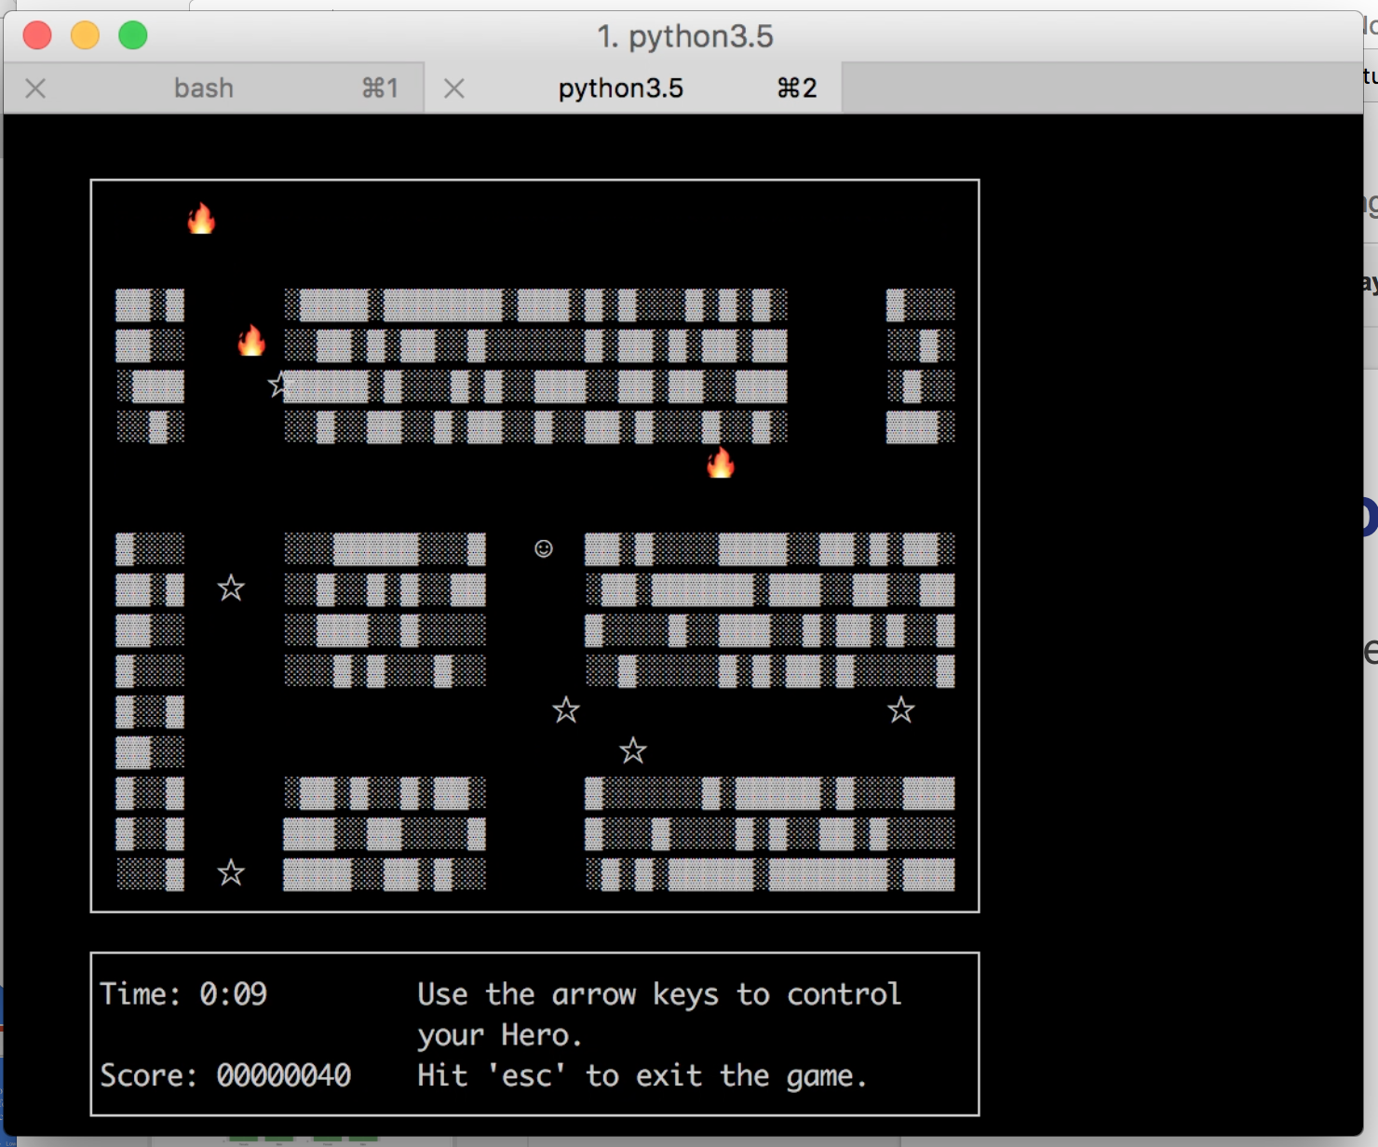
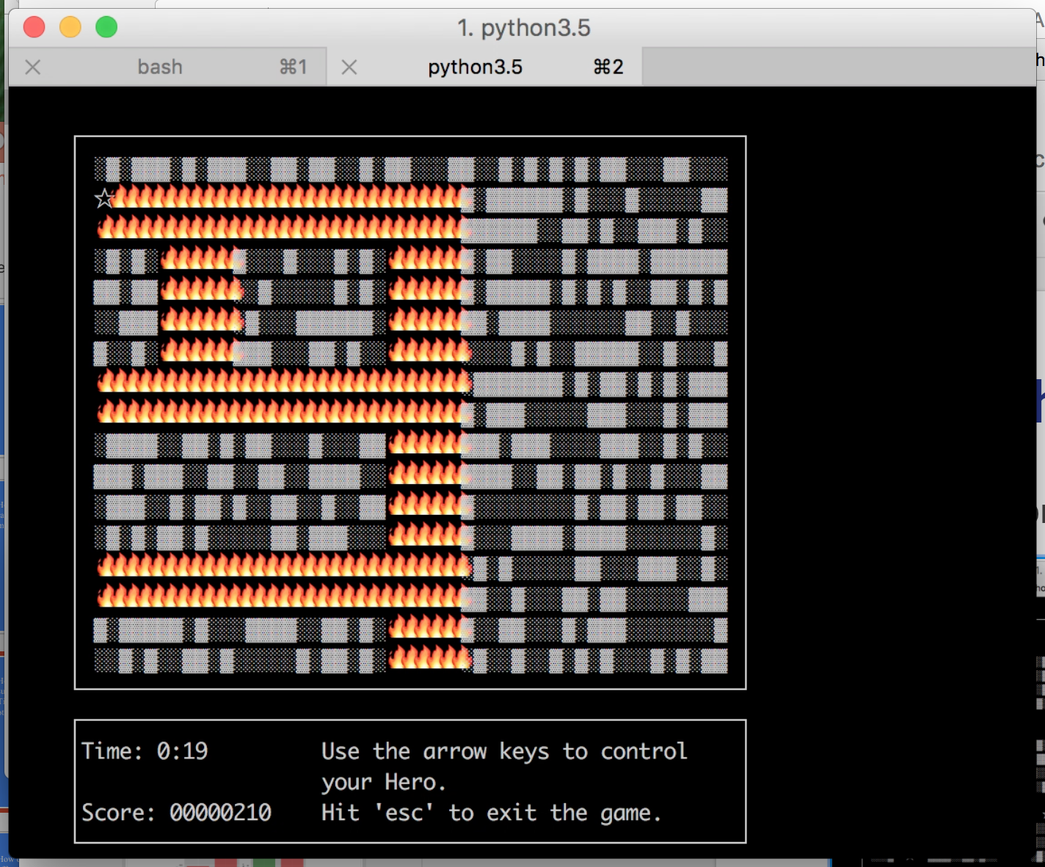
Student Showcase | Project 1 - Object Oriented
Maze Walker by Collin Reinking
Demo
In the repository: W200CourseOverview/project_1/MazeWalker_CollinReinking/

Slide 61
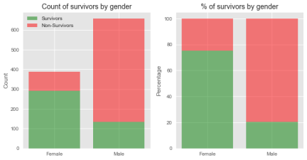
Student Showcase | Project 2 - Pandas
Titanic survival by Danish Iqbal, Matthew Holmes, Kalvin Kao
In the repository: W200CourseOverview/project_2/TitanicSurvival
Women and children had higher survival

Slide 62
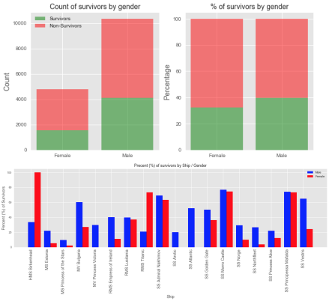
Student Showcase | Project 2 - Pandas
Titanic survival by Danish Iqbal, Matthew Holmes, Kalvin Kao
Analysis of 18 other shipwrecks suggest that “women and children first” less general than they expected

Slide 63
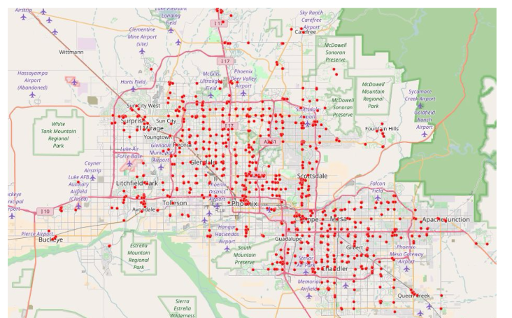
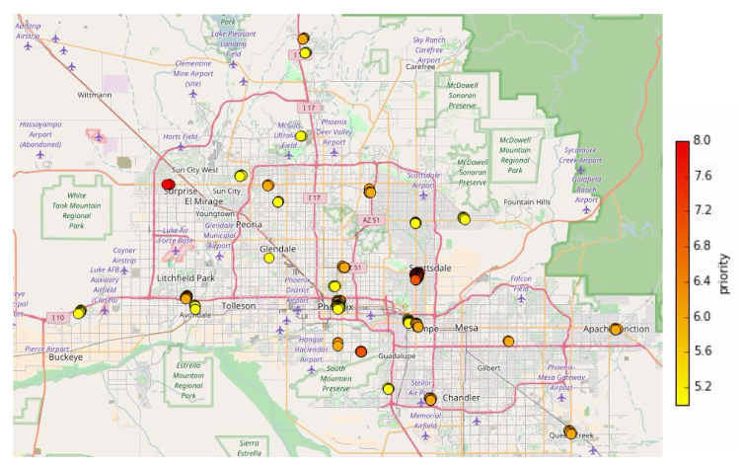
Student Showcase | Project 2 - Pandas
Pizza opportunities by Tom Seddon and Mike Amodeo
In the repository: W200CourseOverview/project_2/PizzaBuisiness
Existing shops in Phoenix sites of opportunity

Slide 64
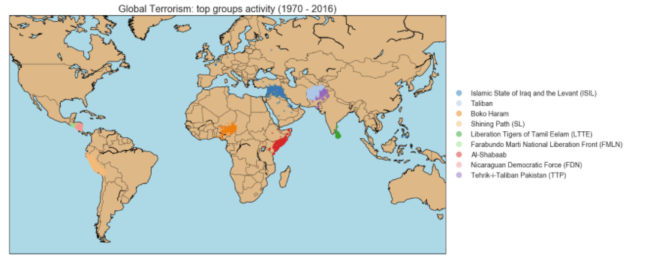
Student Showcase | Project 2 - Pandas
GLOBAL TERRORISM 1970-2016 by V. Nuretdinova, M. Al Zein
Terrorist organizations tend to have a regional focus.
In the repository: W200CourseOverview/project_2/GlobalTerrorism

Slide 65
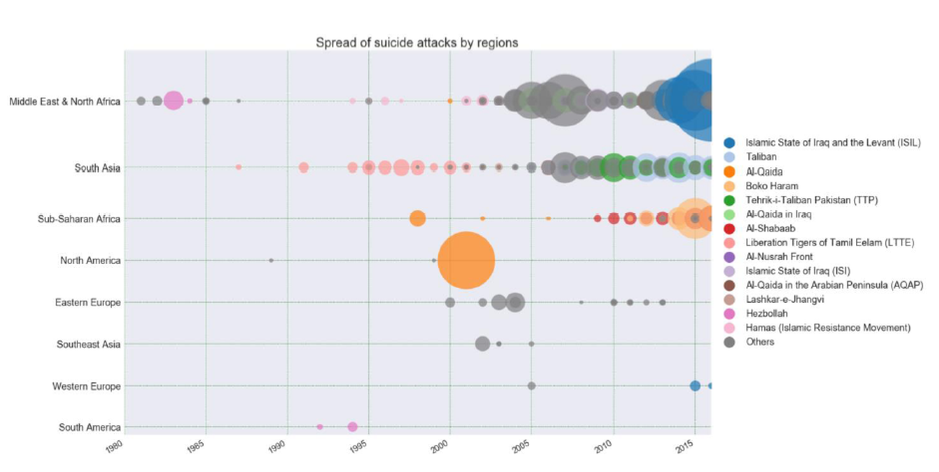
Student Showcase | Project 2 - Pandas
GLOBAL TERRORISM 1970-2016 by V. Nuretdinova, M. Al Zein
We can see historical pulses of terrorism by region.
9-11

Slide 66
Course Overview | Agenda
Review Goals Course Basics The Student Experience The Curriculum Discussion Activity Student Showcase Wrap Up

Slide 67
Wrap Up | Thanks for Coming!
We have a solid course to train students in python
Upcoming improvements
Code updates
Development of Pandas section with the addition of more data visualization
Address the grading issue
Grading - TA
Automated grading and distribution (NBgrader)

Slide 68
Wrap Up | Thanks for Coming!
Any questions?
…
Who’s going next week?

